Slide 1
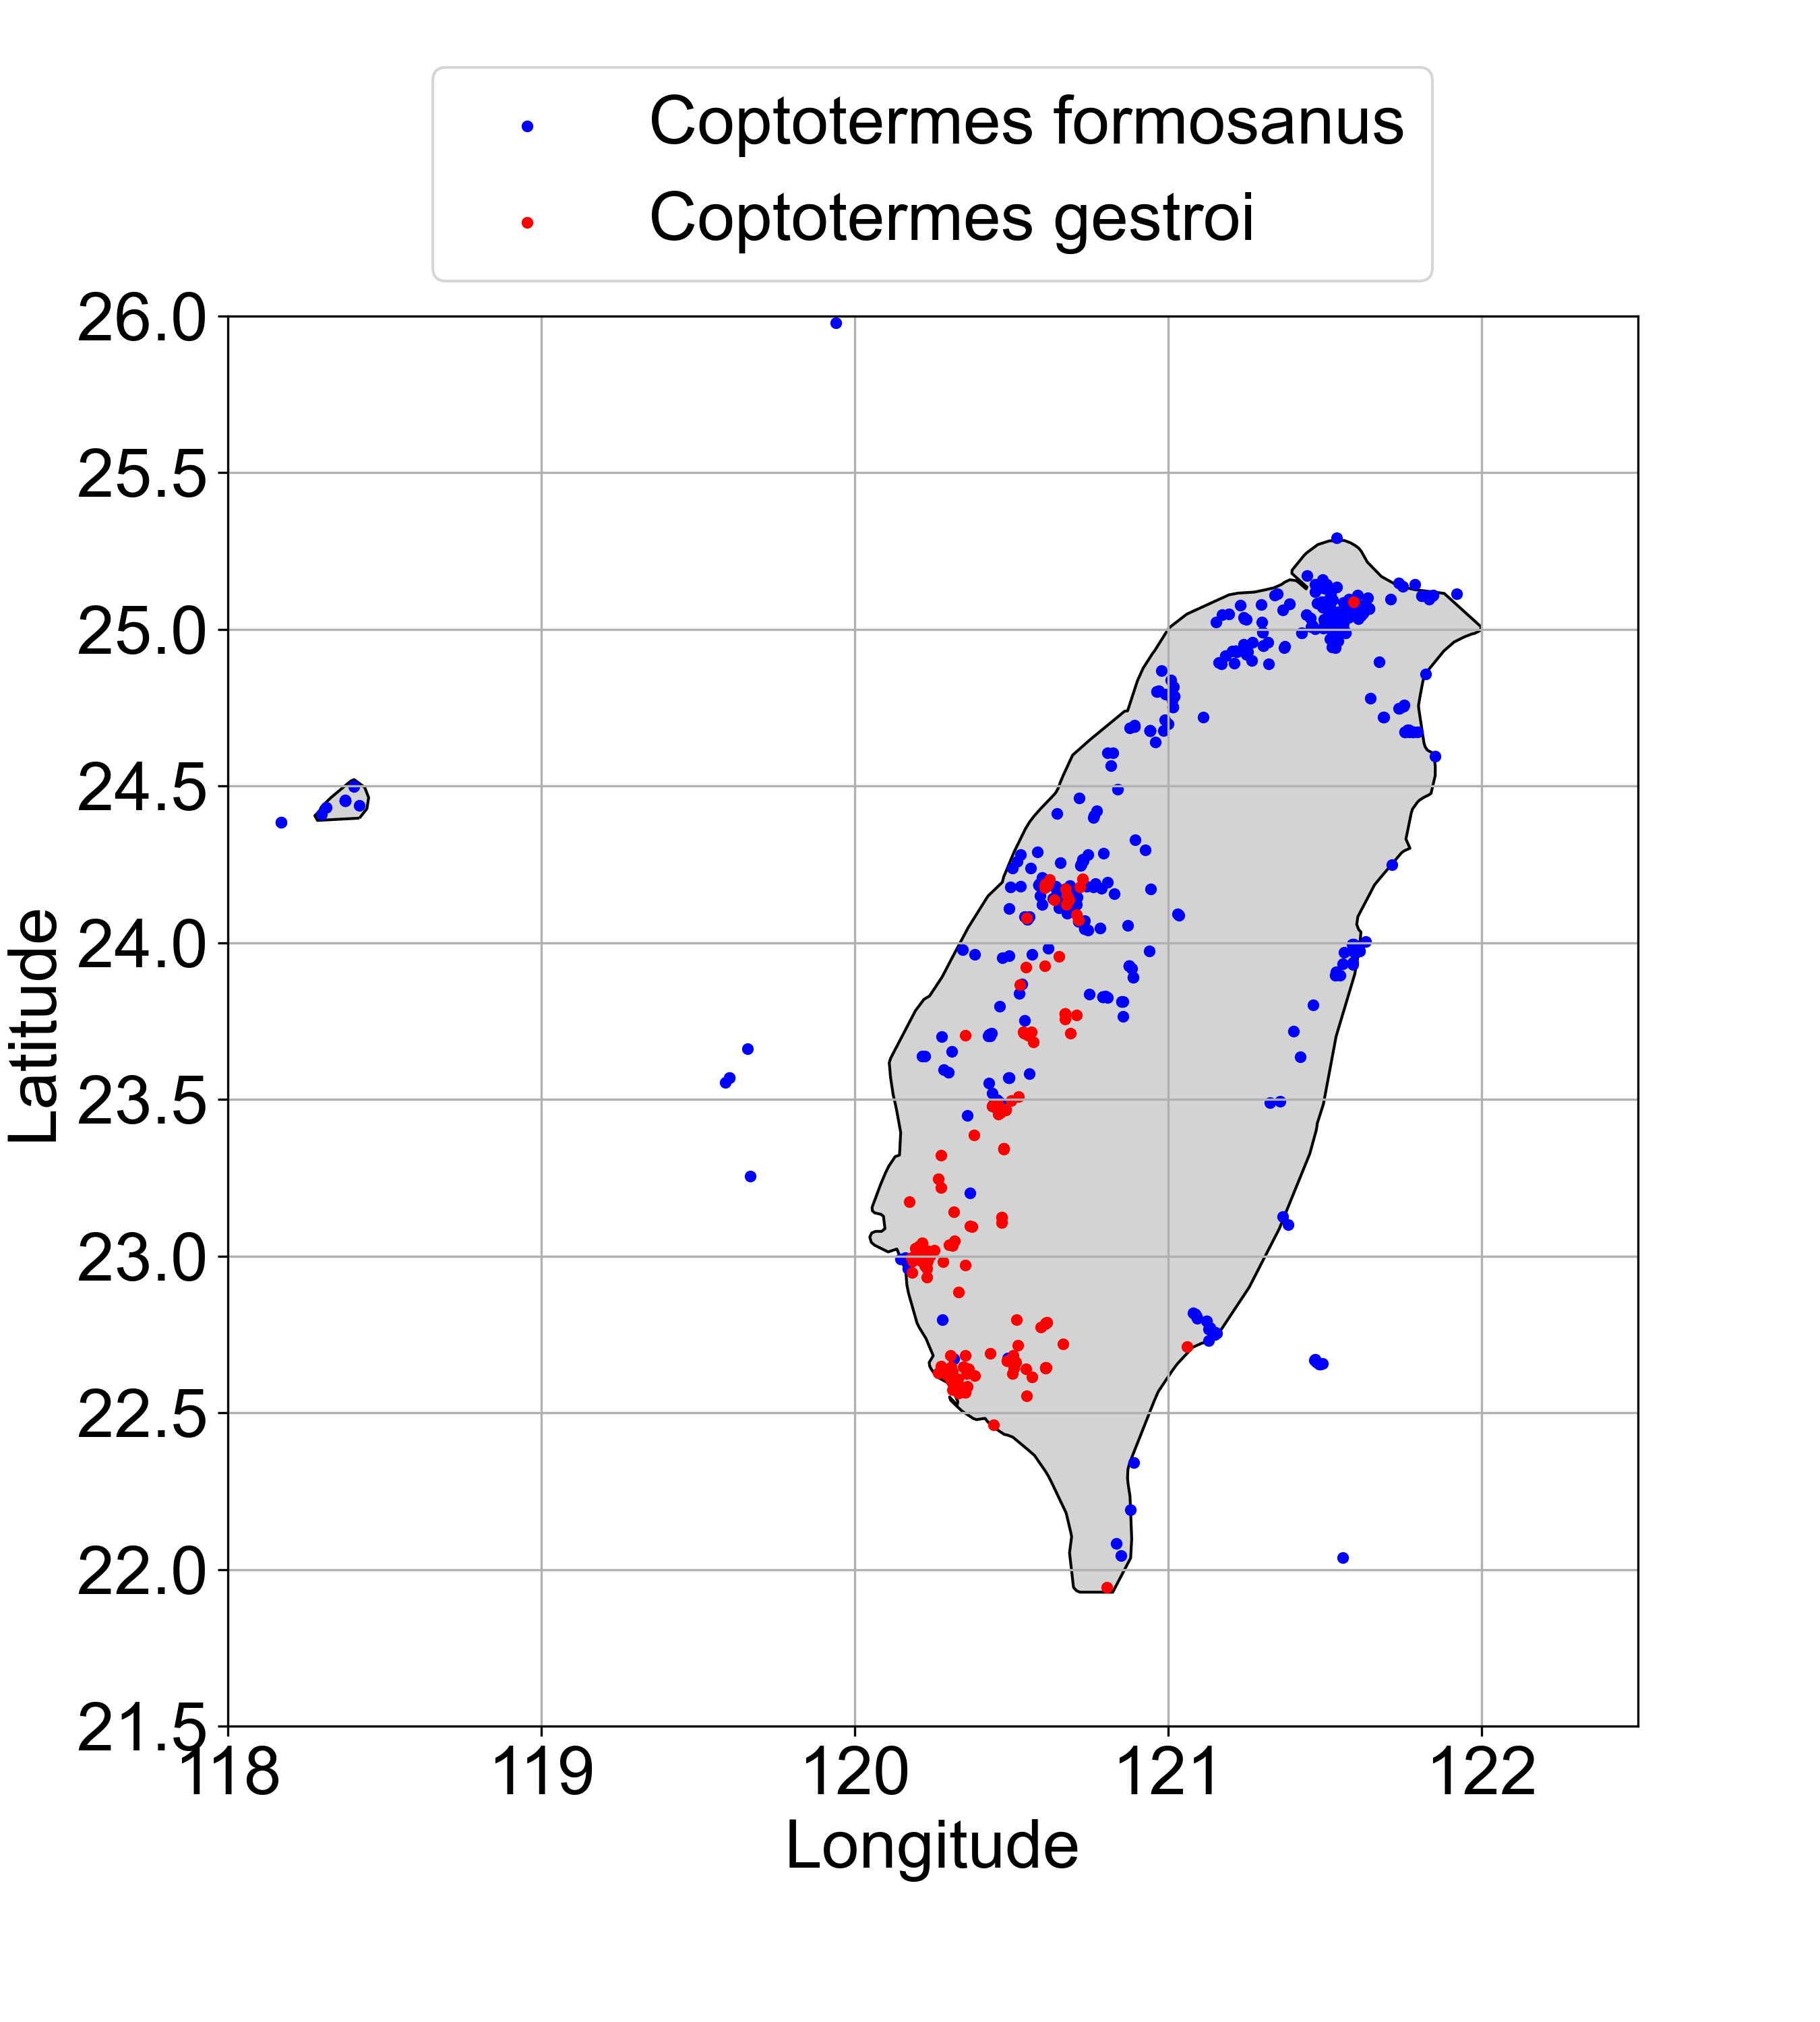
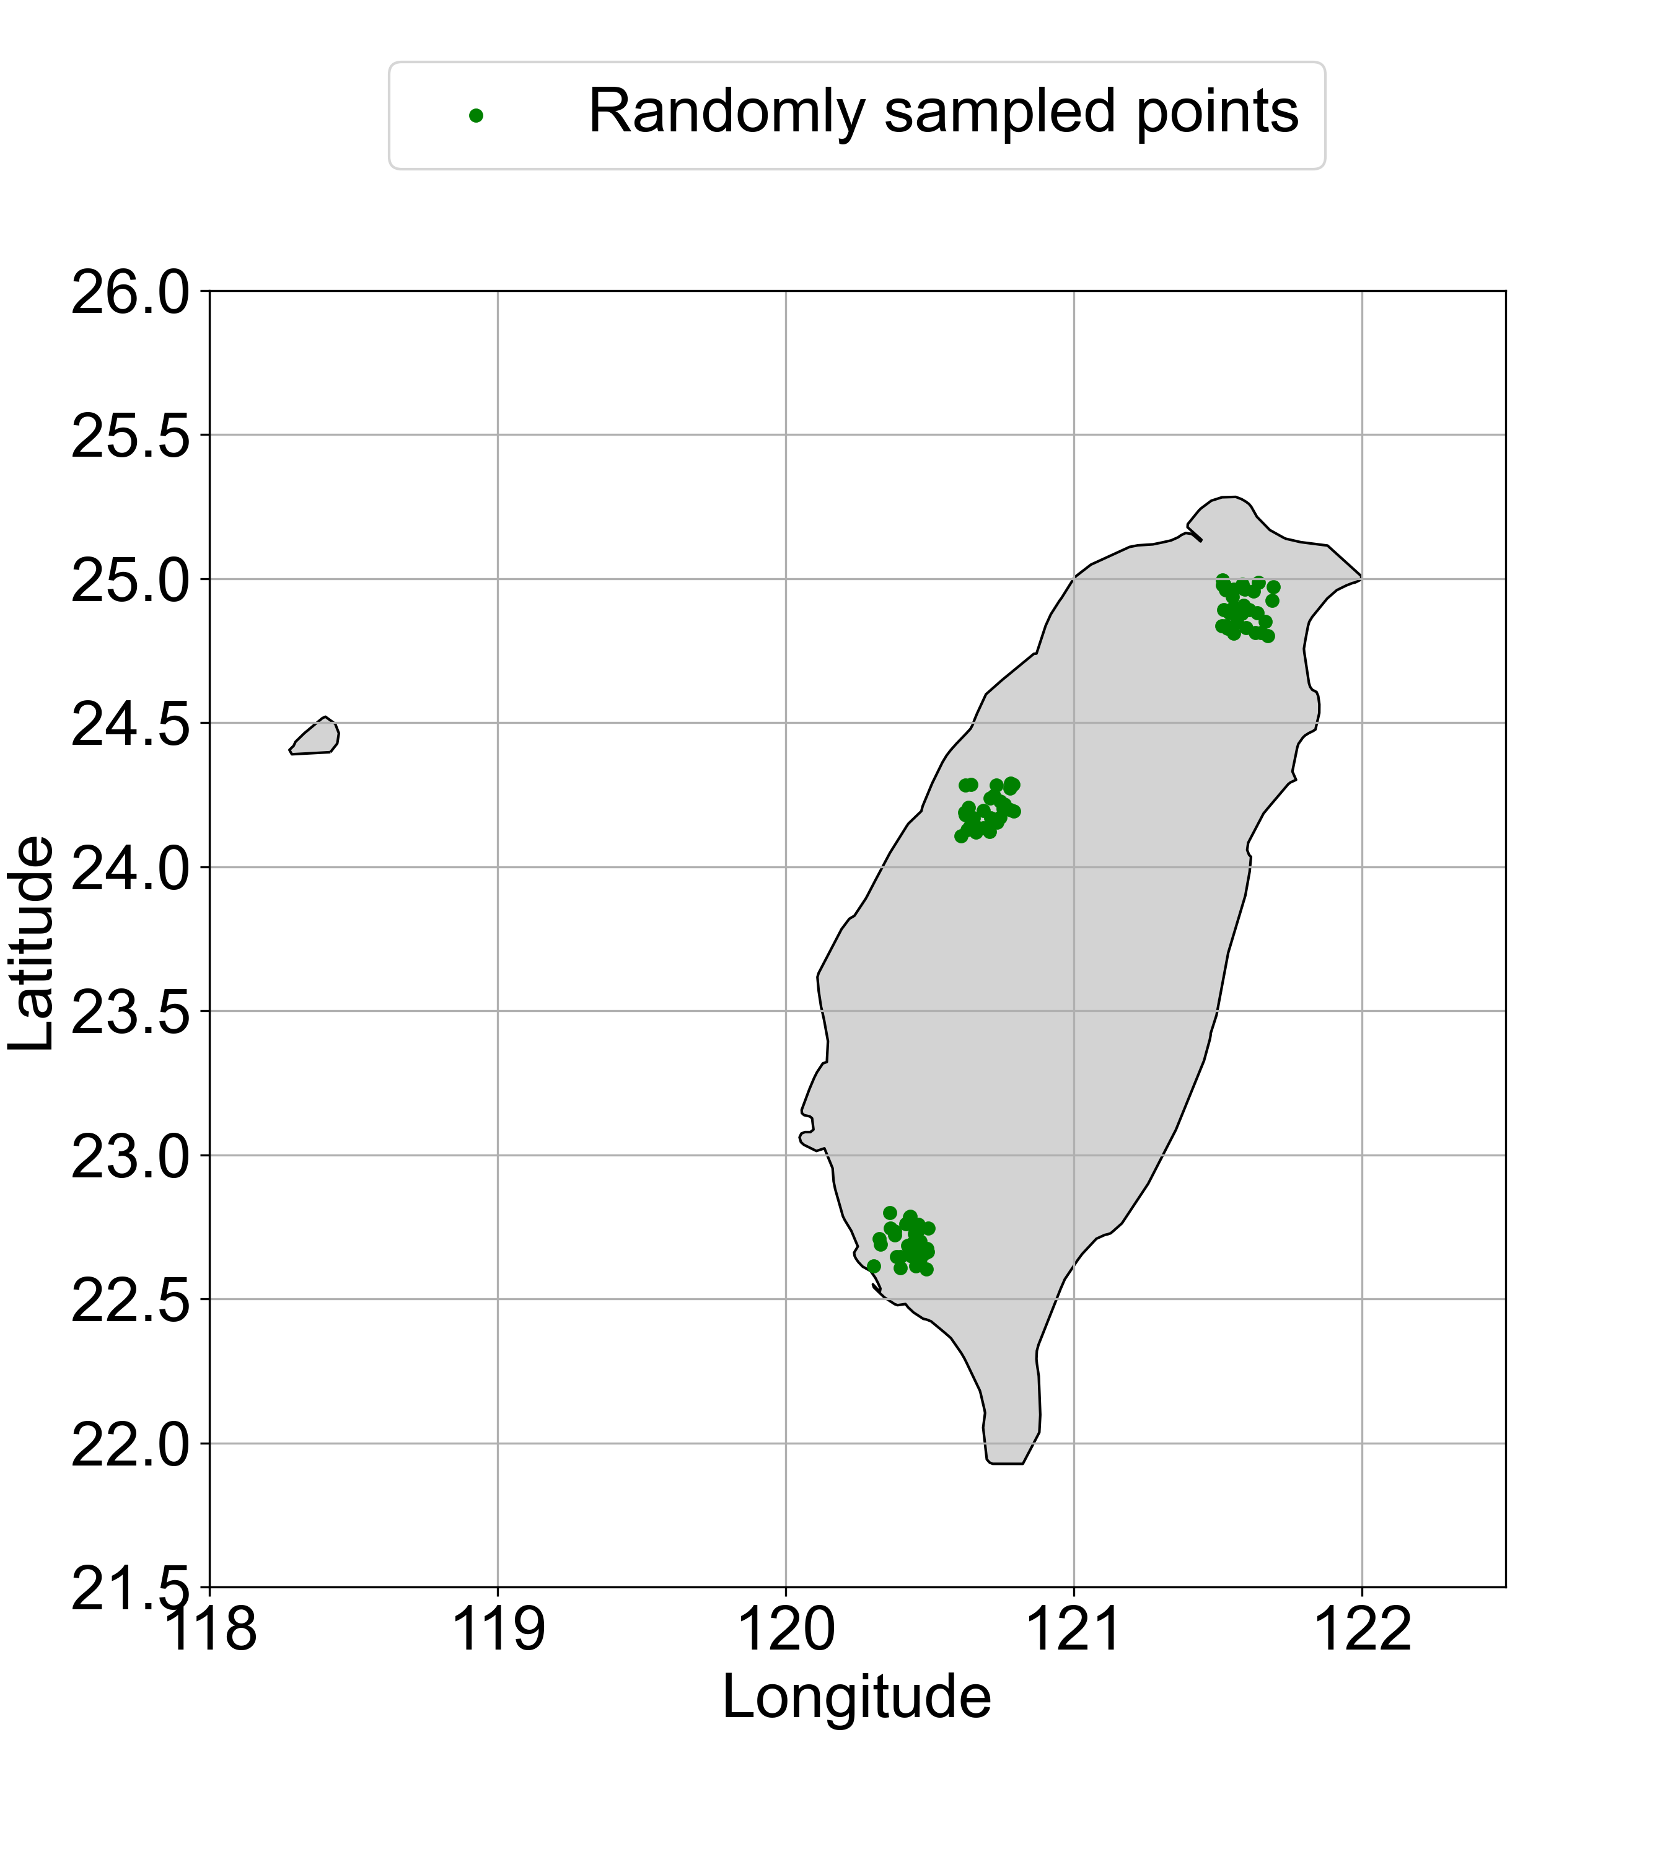
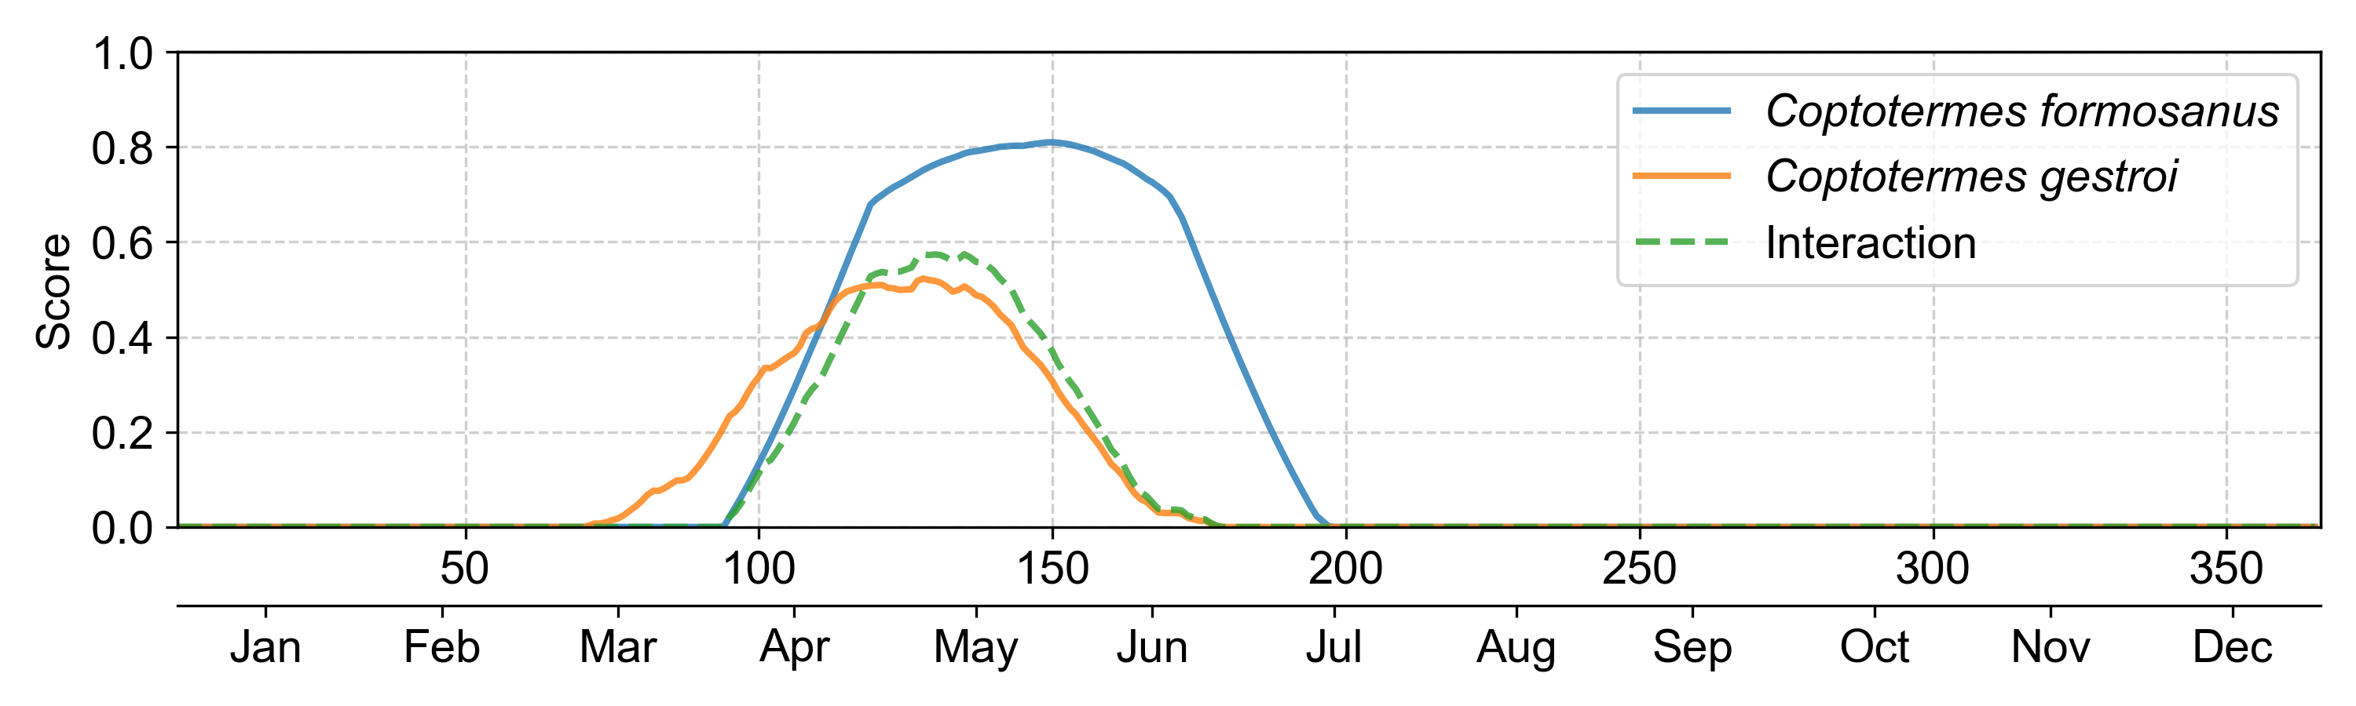
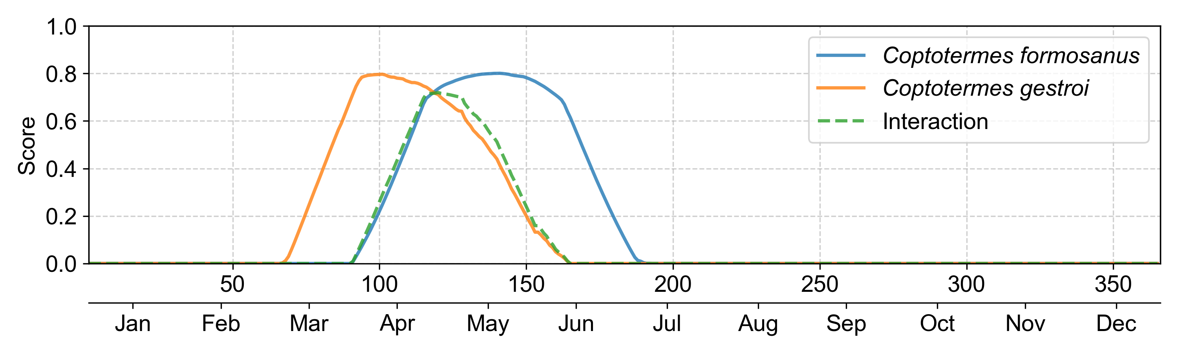
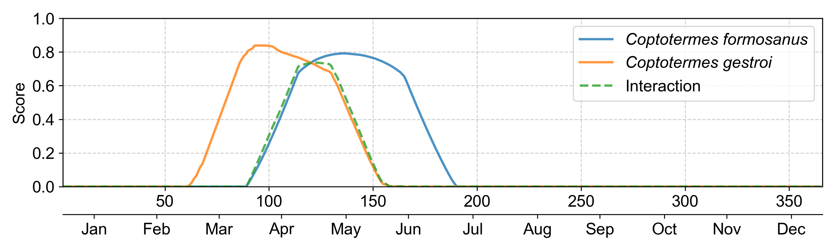
A
B
Northern
Middle-western
Southern
C
Northern
Accumulated
interaction score = 26.00
D
Middle-western
Accumulated
interaction score = 30.19
E
Southern
Accumulated
interaction score = 29.42

